Slide 1
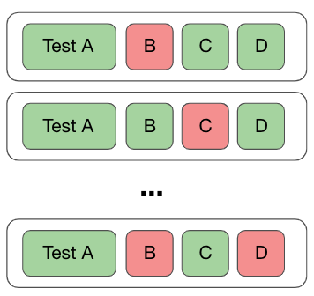
A Combined Approach to Detect Flaky Tests
Haya Samaana
Khaled Badran

Slide 2
Approach
Collect Flaky Tests
Extract Test Smells
Extract Vocabulary
Train and Test a Classifier
Analyze the Results

Slide 3
Collect Flaky Tests
Python projects
~22,000 Repositories
~800,000 Test Cases

Slide 4
Extract Test Smells
Download the test files
PyNose for test smell Extraction
20 different test smells

Slide 5
Extract Vocabulary
Extract Test Body
Remove Stop Words
Tokenize

Slide 6
Train and Test a Classifier
Prepare the data for the model
Train and Test splits

Slide 7
Analyze the Results
Recall, Precision and F1-Score
Information Gain

